Slide 1

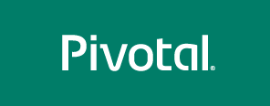
Understanding Pivotal Cloud Foundry
Matt Gunter
Sr. Platform Architect

Slide 2
PCF Workshop Flow
Pivotal’s Areas of Focus & Customer experience
PCF architecture
Deploy an application - staging process
Scale an application - memory, disk, instances
Deploying applications with manifest files
Connecting applications to services - service broker
Spring Cloud Connectors and reading environment variables
Overview of Java buildpack
Upgrading buildpacks for deployed applications
Application logs & forwarding to syslog drain
Monitoring applications on the platform
Blue green styled deployment

Slide 3
Pivotal Areas of Focus
Cloud Native Platform (PCF)
Learn and Change Quickly
Combine Apps and Data
Leverage Cloud Agility
Data Science
Multiple Industries
Combine Data, Apps, and Methodology
Continual Innovation
Pivotal Labs
Test-Driven Development
Pair Programming
12-Factor Apps
Cloud Native Platforms
Dev-Ops

Slide 4


Pivotal’s Purpose is to
“Change the way the world buids Software”
Development (People)
Integrated Teams (Business & Development)
Agile Practices
Continuous Delivery
“It’s definitely around speed to market, but it’s also about getting it right faster” JPMC CIO
Speed
Scale
Cost
Analytics & Learning
Cloud-Native: Scale-out, Cost-effective
Choice of Semantics (SQL to Deep Learning)
Open, Broad Ecosystem
Platform
Optimized for Modern Development
Continuous Delivery
Microservices
Secure/Manageable
Open, Multi-Cloud (private & public)
Broad Ecosystem
© 2015 Pivotal Software, Inc. All rights reserved.

Slide 5











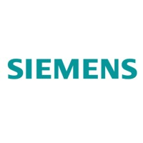

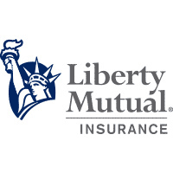
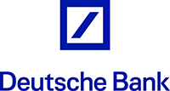
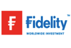

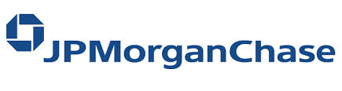
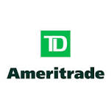





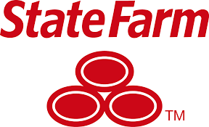


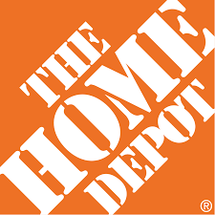

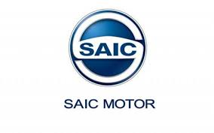
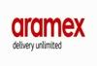
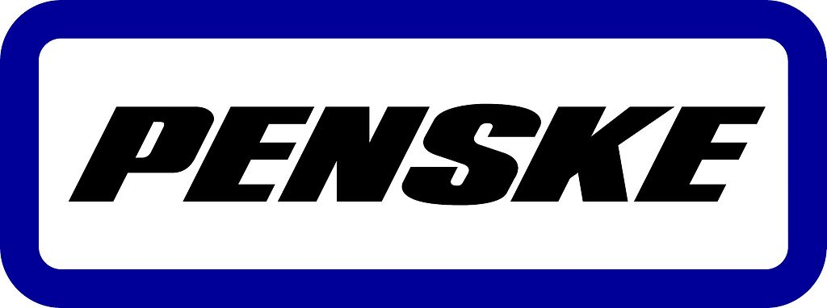
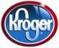

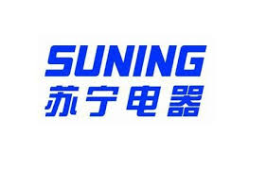

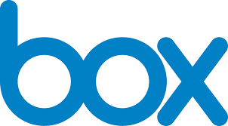
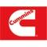
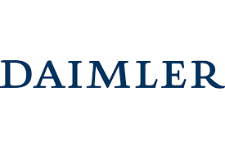
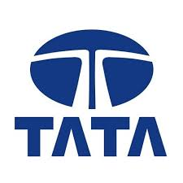





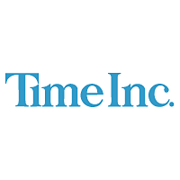


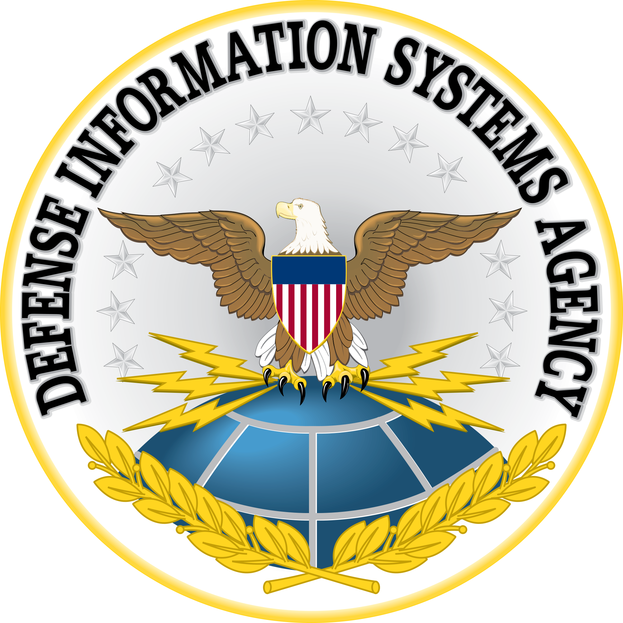



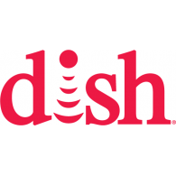




Worldwide, Cross-Vertical Customer Adoption
Confidential
Internet of Things
Telco / ISP
Insurance
Financial Services
Retail / Transport
High Tech / Industrial
Media / Services
Government
Education
Notes:
Cloud native is not something that’s in the realm of cloud giants anymore.
Right now, in Insurance the top 3 companies by net premiums- Allstate, Statefarm and Liberty Mutual – are our customers
Top U.S telcos, ATT and Verizon are in the top 3 Telcos.
The number 1 bank in US, JPMC.
We have customers who are industry leaders in a variety of verticals and geographies. This is just sample.

Slide 6


Transformation of With Pivotal: What can you Expect
Effort to Develop App
Reduced via Pivotal Labs Methodology
Time to Market
Baseline Capability Derived from Pivotal Cloud Foundry Platform
TIME
Allstate: 100 days < a day
3rd Yr
GE: Months < a week
Ford: Months < a week
BNY Mellon: 8 Months < a day
Notes:
https://www.ge.com/digital/blog/ge-cloud-foundry-summit
https://media.ford.com/content/fordmedia/fna/us/en/news/2015/12/15/ford-teams-with-pivotal-to-speed-development-of-connected-car.html
See details slide for Allstate
Bny mellon: https://www.youtube.com/watch?v=HXp9_Y2rWCo&index=31&list=PLhuMOCWn4P9gGrKEtCBKYpEl5BXGBCsQZ
TD Ameritrade ad: https://www.ispot.tv/ad/7QVs/td-ameritrade-stickers

Slide 7
Transformation With Pivotal: The Journey
PCF –Year 1
Labs –Project 1
PCF Dojo (Operations)
Labs -Project 2
Pcf –Year 2 Labs –Project 3
Investment
$250K
$750K
$1.25M
$1M
TIME
Start
3 mo’s
6 mo’s
2nd Yr
18 mo’s
3rd Yr
Predictability Benefits
Cloud Native Platform
New Dev Practices
Discipline / Quality
Culture / Alignment
Optimizations
Reduced Effort
Improved Velocity
Realize new Opportunities
Business <–> IT Shift
Trust and Communication
Shared Risk
Productive Innovation
Returns
Operational Confidence
Uptime
Performance
Security

Slide 8
Transformation With Pivotal: The Detail
Jabil Progress
Commitment to
Continuous Delivery &
Cloud Native Approach
* PCF Deployed
* App Dev ½ point
Cont Del
Understood
Cloud Native
Understood
1st Product
completed
Other apps
deployed to PCF
Continuous
delivery becoming
default approach
* IT Transformation
well underway
* IT speed drastically improved
* IT becoming prescriptive
to the business, rather than
project order-takers
Building Software is A Strategic Asset
Annual Subscription and Discretionary Spend for Training and Projects
Investment
PCF 1st Yr
& First Labs
App Dev Proj
PCF Dojo –
Optimization
2nd Labs
App Dev Proj
PCF 2nd Yr
Subscription
%100 Growth:
$1M
:
$1.25M
$250K
$750K
TIME
Start
3 mo’s
6 mo’s
2nd Yr
18 mo’s
3rd Yr
Past Value Delivered
Predix becomes
GE Digital,
a $6B Business
Bill Ruh now CEO,
GE Digital
GE
* Predix Start
* CEO Jeff Immelt
personally engaged
Simultaneous
Product Builds
Predix MVP
completion,
Customer sales begin
Predix to become
$1B Business Unit,
Bill Ruh VP IT recognized
Predix grows much faster
than expected, head of
Predix Bill Ruh promoted
* Ford Sync
struggling
* Tesla taking
market by storm
* CEO Mark Fields
personally engaged
* PCF Deployed
* App Dev ½ point
Cont Del
Understood
Cloud Native
Understood
New Sync MVP
completed
New vision for Ford
begins to shape
with Ford execs
CIO Magazine: “Ford
changes culture
with Pivotal”
December 2015
Forbes Magazine: “Ford
Invests $182M
in Pivotal to become
world class software company”
May 2016
FORD
ALLSTATE
* App Dev ½ point
Cont Del
Understood
Cloud Native
Understood
1st MVP
product completed
in 6 months,
usually an 18 month
to 2 year cycle
New Product delivery
time up 400%
New products now
created and test digitally
with low risk
Finished code took
100 business days
to go live
40 + years of legacy IT
Andy Zitney, SVP IT
“What used to take
100 business days,
we now do it minutes.”
Fortune Magazine:
“Pivotal reinvents
software delivery at
Allstate, Garmin, Humana,
and Comcast”

Slide 9
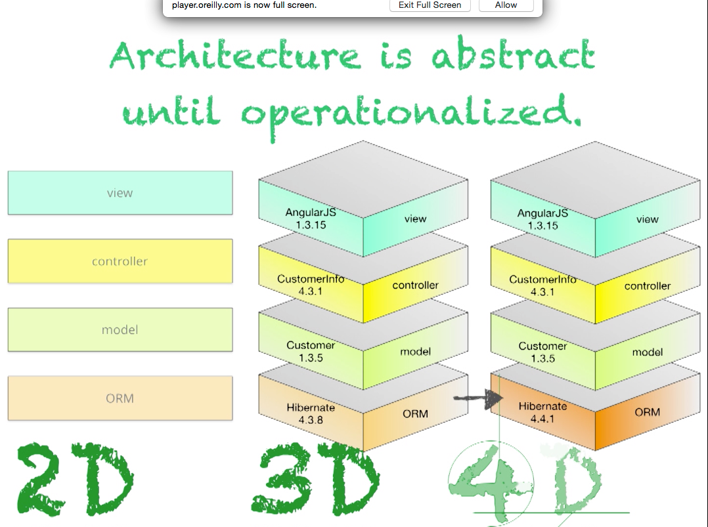
Moving from 3D to 4D
By Neal Ford (Thoughtworks)
Notes:
https://player.oreilly.com/videos/9781491932636

Slide 10
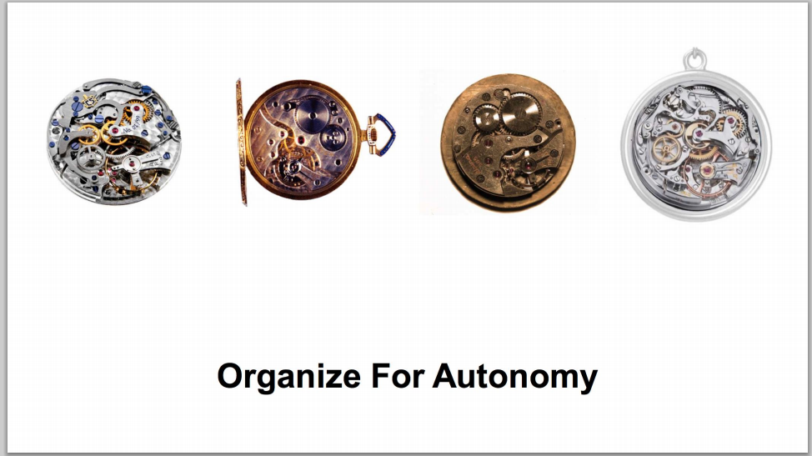
New 4D Focus: Accelerate Innovation
Lowers Cost of Failure
Reduces Friction
Speeds Iteration
High Frequency of Deployment
The right org/size, api contracts, & expectations
Amazon Summit 2014
Notes:
http://media.amazonwebservices.com/jp/summit2014/TE-01.pdf
Add conways law and inverse conway maneuver

Slide 11
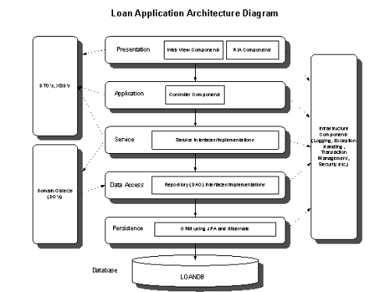
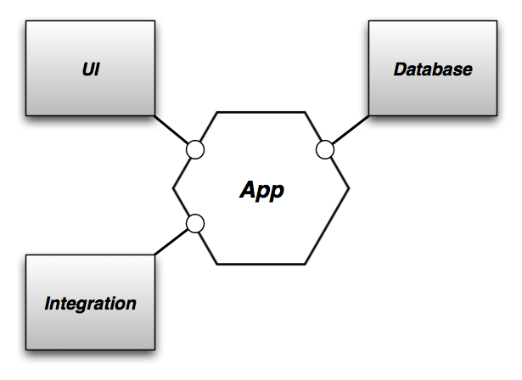
“Life Preserver” Rather than a “Raft”
Hexagonal Architecture by Alistair Cockburn - 2005

Slide 12
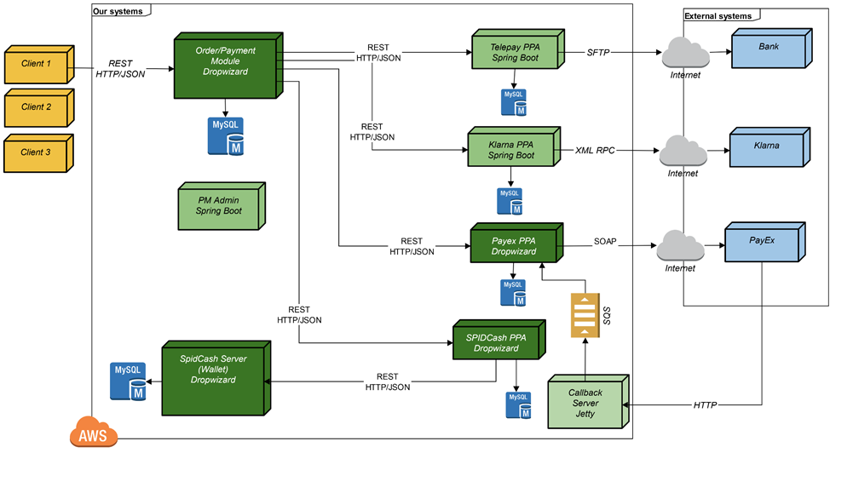
Architecture built for Autonomous Change
Comparison of Spring and Dropwizard - 2015
Notes:
http://www.schibsted.pl/2015/07/spring-boot-and-dropwizard-in-microservices-development/

Slide 13

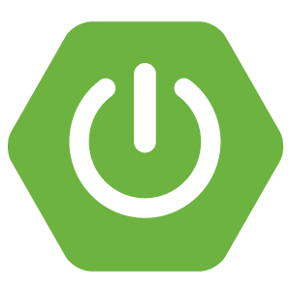
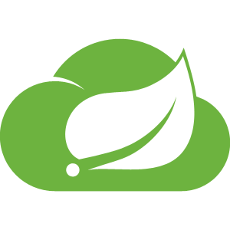



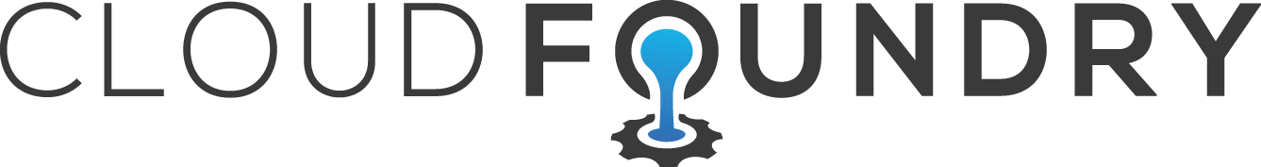
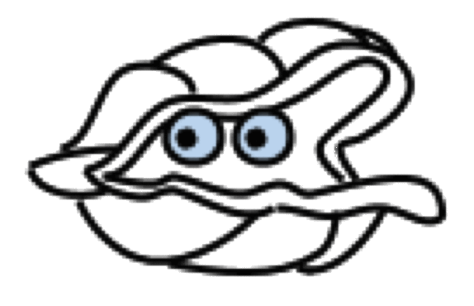
Well-Defined Expectations for Dev and Ops
Application Framework
Language framework for microservice-based architectures including components for service discovery, metrics and circuit breakers.
Spring
Boot
Spring
Cloud
Dev
Contract: 12 Factor Application
Platform Runtime
Application container runtime with attachable backing services, automated CI/CD, routing, health management and logging.
Dev
Ops
Contract: BOSH Release
Infrastructure Automation
A single deployment API for provisioning for bit-for-bit, consistent, self-healing deployments across any private or public cloud.
Ops
BOSH
Notes:
Now let’s spend a more time going a little deeper on the Application Framework.
These are the tools that provide all the functionality architects and developers need to design and deliver cloud native applications.
In particular these tools should enable creating microservices and 12 factor apps with minimal friction.
Organizations using these tools, and the supporting platform capabilities, create scalable secure applications while releasing new features every week, if not daily or hourly.
Cloud Native apps are designed for microservices at multiple levels for success – they must be directly supported in the app framework, the runtime, and at the infrastructure automation level to account for and offset the added complexity that microservices and distributed computing incur.
Each layer represents an important contract (integration) with the framework. For example – an app and the platform agree to to adhere to 12 factor design (12factor.net) principles to allow the infrastructure automation to do it’s job. With an application framework and infrastructure automation that adheres to these contracts, the platform can keep a substantial range of extremely powerful promises. So what is a cloud-native application? Let’s examine each piece in turn:
Cloud Native Application Framework
leverage existing skillsets with the most popular Cloud Native Java framework
utilize service discovery, client load balancing, and circuit breakers with ease
enables a modern, secure microservice architecture with reusable patterns
the same code Pivotal and Netflix use to deliver world class applications
Cloud Native Runtime Platform
easily deploy to an enterprise class application centric container scheduler
developer enabling self-service workflows
policy enforced role based access
the same platform Pivotal uses to deploy applications for our clients
Cloud Native Infrastructure Automation
manage services, not servers
on demand API driven provisioning
bit for bit consistent deployments with canaries and rolling upgrades
the same automation Pivotal uses to manage Pivotal Web Services
Cloud Native Empowered Culture
high trust low friction processes enables speed and safety
policy driven automation makes doing the right thing easy
confidence and competence supported by continuous integration and learning
transparency, communication and alignment across dev, ops and the business
Devops
What’s the outcome of going cloud native? Consistency and cost saving, project over project. No undifferentiated heavy lifting. Less “Day 2” adoption issues from un-integrated point solutions.
Now, lets really start to focus on the Application Framework and see where Spring Cloud plays an important role.

Slide 14
Ad Hoc CLOUD ADOPTION is hard, expensive
Non – Native Cloud App
APPLICATION FRAMEWORKS
CONTAINER SCHEDULERS
IAAS AUTOMATION
Spring Boot
Marathon
Puppet
Dropwizard
Docker Swarm
Chef
Seneca
Kubernetes
Ansible
Ruby on Rails
Chronos
SALT
IaaS – VMW, AWS, Azure, GCE, OpenStack
Notes:
What’s the alternative to an integrated cloud native solution?
It’s what some enterprises are doing today: adopting cloud a-la-carte today, using a combination of individual cloud services or technologies: Just EC2 + services. Just Docker. Docker with Puppet/Chef/Ansible/SALT. MesosSphere or Kubernetes with Docker on EC2. etc etc.
Non-native, unintegrated approaches don’t offer the economy of scale inherent in a cloud native approach – partial approaches miss the mark. Most enterprises are considering to deploy multiple cloud applications, and would save $$$ if the process was repeatable – which you don’t get from using point solutions.
Partial adoption places your efforts at the mercy of “Day 2” adoption issues – rife throughout the various, unintegrated layers of a cloud native solution. The next app is almost certain to require a different set of choices and trade-offs, so any economy of scale from the last effort goes out the window.
Cloud native apps build on a repeatable, structured approach to the app framework, the platform runtime and the infrastructure automation. Why reinvent things for every project?
12 factor app development and architecture, cloud resource connectivity
Security
Container Automation (create/scale more containers)
IDM
Log and metrics aggregation
APM
Etc etc

Slide 15

Spring and Microservices on PCF
Enable 12 factor contract for app + platform runtime
Remove dev complexity by orders of magnitude
Externalizing configuration is simple with Spring Boot
Boot profiles intelligently adapt configuration to different environments
Autoconfiguration for Cloud Services
Eliminate boilerplate code
Implement best practices / patterns
Production ready monitoring
Autoconfigure and embed app server
Message / Data Driven Microservices
Microservice Infrastructure
Message pipelines to ingest, transform, store, and analyze data
Handle streaming and batch data
Tools for non-expert developers
Service Discovery
Intelligent Client Load Balancing
Circuit Breaker
Configuration Server
Notes:
CN frameworks certainly need to be able to address modern enterprise development, typically on lightweight OSS Java containers. (e.g. Tomcat, Jetty, Undertow).
A Cloud Native Framework goes beyond providing embedded libraries for individual service development.
It also provides annotation driven, declarative setup of runtime services for distributed computing support ( e.g. Eureka, Hystrix, Turbine)
A contract is required between the application code , and the production platform – expressed in 12-factor design principles.
With that contract in place, a cloud native platform can automate all the other middleware and install/configure/operate /manage/secure external services.
Need to scale the service discovery servers to mirror a scale up of microservice instances that comprise your distributed application? For cloud native frameworks, it’s no problem.

Slide 16
….PCF Drill Down

Slide 17
PCF Topics to Touch on….
Push / Bind / Scale
CLI, Manifests, API & Aps Mgr
Orgs, Spaces, Users & Quotas
Buildpacks & Upgrading Buildpacks
Logging
Auto scaling
Domains and routes
Basic Troubleshooting, Logs, & monitoring
Basic Services Overview & Spring Cloud connectors
Blue/Green Upgrades and DB Migrations
Notes:
We’re introducing BOSH in the PCF Basics and Architecture 301 because BOSH is the tool that deploys PCF. It deploys PCF Elastic Runtime and PCF Services.

Slide 18
Pivotal Cloud Foundry Architecture
Platform Runtime (Elastic Runtime)
Services
Routing
Container Scheduling
Service Discovery
Configuration
Database
Application Framework
Big Data
12 Factor Apps
Microservices
RESTful Services
Circuit Breakers
Object Storage
Mobile
Spring Boot
Ruby on Rails
Node.js
.NET
Build CI
Logging & Metrics
Messaging
User Provided
Operations
Zero Downtime Deployments
Failover & Recovery
Scaling
Security Patching
Platform
Upgrades
Notes:
Before diving into BOSH we introduce the major components of the platform. Then we explain the platform infrastructure automation capabilities in the context of our structured (or opinioned) platform. The following BOSH sections would explained in more detail.
PCF is made of 3 major components – Operations (Ops Manager), Platform Runtime (Elastic Runtime) and Services. All, mostly deployed, by BOSH
Now we’ll briefly talks about the components

Slide 19

DEMO CF Push, Bind and scale
Notes:
THIS SECTION INCORPORATES SLIDES FROM “PCF Basics and Arch 301” Deck

Slide 20

Deploying an Application
Platform Runtime (Elastic Runtime)
Blobstore
Service
credentials
Upload app bits and metadata
DB
push app
+ app MD
Cloud Controller
Service Broker Node(s)
Create and bind services
Stage application
Deploy application
Manage application health
Router
Container Management - DIEGO
Cell
DEA
Brain
DEA
DEA
+
=
Notes:
We keep the cf push workflow simple and don’t get into the details of DIEGO. We only keep the BRAIN and Cell.
Cloud Foundry PaaS – Pushing an Application with Diego
App deployment: what has changed?
1- Domain specific (notion of apps) -> Abstractions (notions of LRPs and Tasks). App staging is a Task. App start is launching a LRP.
2- Platform specific (linux) -> Supporting multi platform (Windows & Linux) enabling running also .NET apps, thanks to our new Container implementation: Garden
What’s more, there is a 3rd workflow supported: Docker on Linux
3- New Auction-based workload scheduler: Cloud Controller no longer in charge of deciding where AIs are spun up. Auctioneer manages the process running an auction, making it more optimized.
With Diego in place, more loosely-coupled components take part in the process, stripping down the Cloud Controller from too many previous responsibilities, making it easier to maintain and evolve the entire architecture.
The Cloud Controller handles the routing of client requests internally through the Cloud Controller Bridge. It also manages the Blobstore to store packages and droplets and the DB to store App Metadata and Service credentials. Blobstore could be internal or external, depending on the setup.
A service gateway provides an interface for services (native or external).
More in the next slide about the Cloud Controller Bridge (CC-Bridge), the Bulletin Board System (BBS) and the Auctioneer in the next slide
Apps run in a CELL, part of the new Cloud Foundry Runtime, called Diego
Routers manage application traffic.
Diego handles all health management for apps (now LRPs), through a series of single-purpose components: Nsync (part of the CC-Bridge), BBS (part of Diego DB) and the Converger (part of the Diego Brain)
Apps are accessed directly through the router while web and CLI clients (e.g., vmc, STS) access Cloud Controller via RESTful services.

Slide 21
Creating and binding services
Service
credentials
DB
CLI
create service (HTTP)
Cloud Controller
create service (HTTP)
Service
Broker
reserve resources
Data
Service
Router
bind service (HTTP)
bind service (HTTP)
obtain connection data
Platform
Runtime
Notes:
NOTE: THIS SLIDE IS THE SAME WE USE IN THE PCF Basic and Arch 301 presentation – KEEP THEM IN SYNC

Slide 22
Staging an Application
Blobstore
DB
Cloud Controller
Cell
Router
Detect
Compile
Upload
System
Buildpacks
Yes
No
+
=
Platform Runtime
Notes:
The purpse is to simple explain our staging process and introduce buildpacks. We’re not getting into the details of DIEGO.
https://github.com/cloudfoundry-incubator/diego-design-notes#app-lifecycles

Slide 23
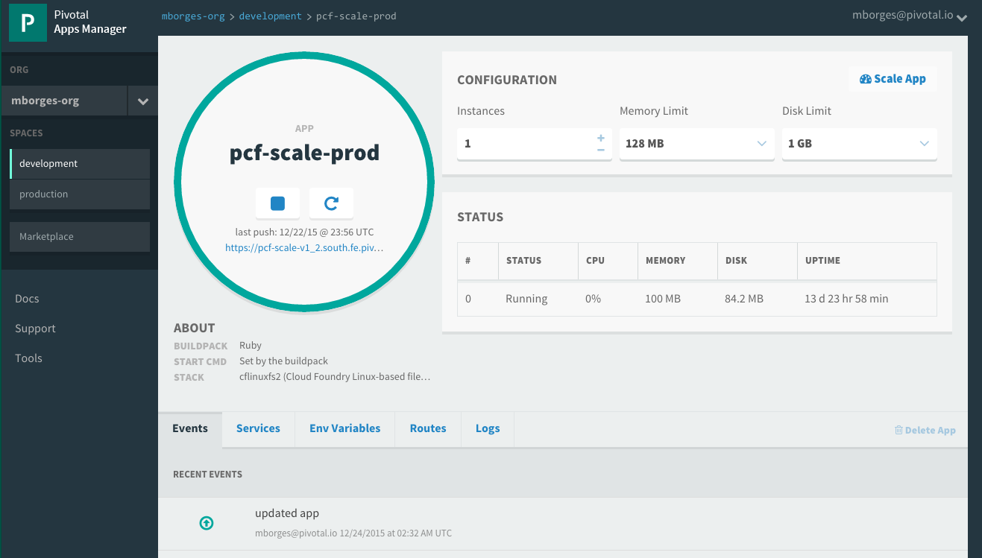

Getting your application to scale
Can be done via CLI:
At deployment time (via manifest.yml or as a modifier to cf push)
During run time without interrupting operations (via cf scale --instances 10)
Can also be done via Apps Manager
© Copyright 2013 Pivotal. All rights reserved.
Notes:
TDB: Update picture – what about slide showing visually

Slide 24
The App-Container Approach - Scaling
Blobstore
Cloud Controller
Container Management - DIEGO
Access App
Router
Brain
Cell
Cell
Cell
Platform Runtime
Notes:
https://github.com/cloudfoundry-incubator/diego-design-notes
At the core of Diego
A distributed scheduling algorithm which orchestrates where containers go and hence where application instance processes are run
Optimizing for application workloads
Implements Demand Driven scheduling of workload
Auctioneer says "I have N pieces of work, who wants them?"
Worker cells then join an auction and the winning cell of each auctioned-off piece of work gets that piece of work
Components of Diego
Tasks & Long Running Processes (LRPs)
Tasks: are processes that are run once and have a finite running time. This might be a script or job to process a piece of data
LRP: This might be a web-server or some other service that continuously accepts input and processes
Tasks are not included in Auction
Cells
Cells are where the Tasks and LRPs are run
These are most analogous to DEAs in the current Cloud Foundry architecture.
Generally one Cell per VM
Brain – implements the core scheduling (auction algorithm) functionality of Diego
Bulletin Board System/Store (BBS)
Where state of Diego cluster is stored
Up to date cache of cluster state
“Holds” CF actions
Start/Stop instances
Start one-off task processes
Backed by ETCD which acts as consistent store
Components of Diego Brain
Auctioneer – holds auctions for LRPs and Tasks
Also determines which instances are removed when scaling down
Converger - Keeps cluster state consistent using eventually consistent model
Ensures cluster state is consistent with the desired state, that is, performs convergence
Provides fault tolerance for Tasks and LRPs
Updates BBS with state of cluster
Places requests on BBS
Metric Server – Reads from Metron agents, publishes them to Doppler
Components of Diego Cell
Rep - Represents Cell in Diego
Mediates all communication with BBS where cluster state is maintained
Participates in auction to accept Tasks/LRPs
Runs Tasks & LRPs by working with Executor
Executor –
Implements HTTP API to Create and Delete Containers
Implements Executor Actions such as Run, Download, Upload, Parallel etc
Streams Stdout & Stderr to Metron agent running in the Cell
Garden – the Linux container for Diego
Garden API – the Linux Garden API implementation
Garden-Linux – the Linux container backend implementation
Isolates network, disk, memory, CPU; performs resource management
Runs droplets, tasks, other containers (Docker)
Metron Agent - Forwards application logs and application/Diego metrics to doppler (loggregator)

Slide 25
CLI, Manifest, API, Apps Manager
Notes:
THIS SECTION INCORPORATES SLIDES FROM “PCF Basics and Arch 301” Deck

Slide 26
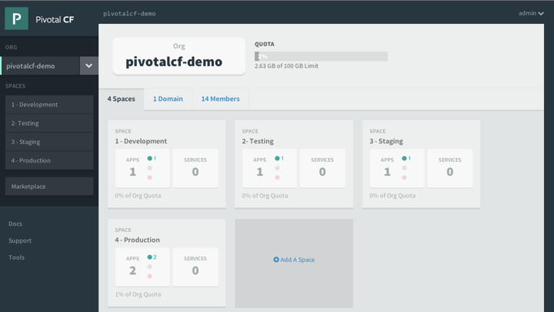
Platform Runtime - Pivotal Apps Manager
Manage Organizations, users, applications and Spaces
Monitor applications logs, services and routes
Access Service Marketplace, create services and bind to applications
Notes:
http://docs.pivotal.io/pivotalcf/console/index.html
This picture allows us to walk thru the basics of Apps Manager. PCF Elastic Runtime self-service UI. ERS is a multi-tenant platform that can be logically divided into Organization and further into spaces. Quotas ensure resources are managed and Spaces further divides organization to manage and control access to application and services.

Slide 27
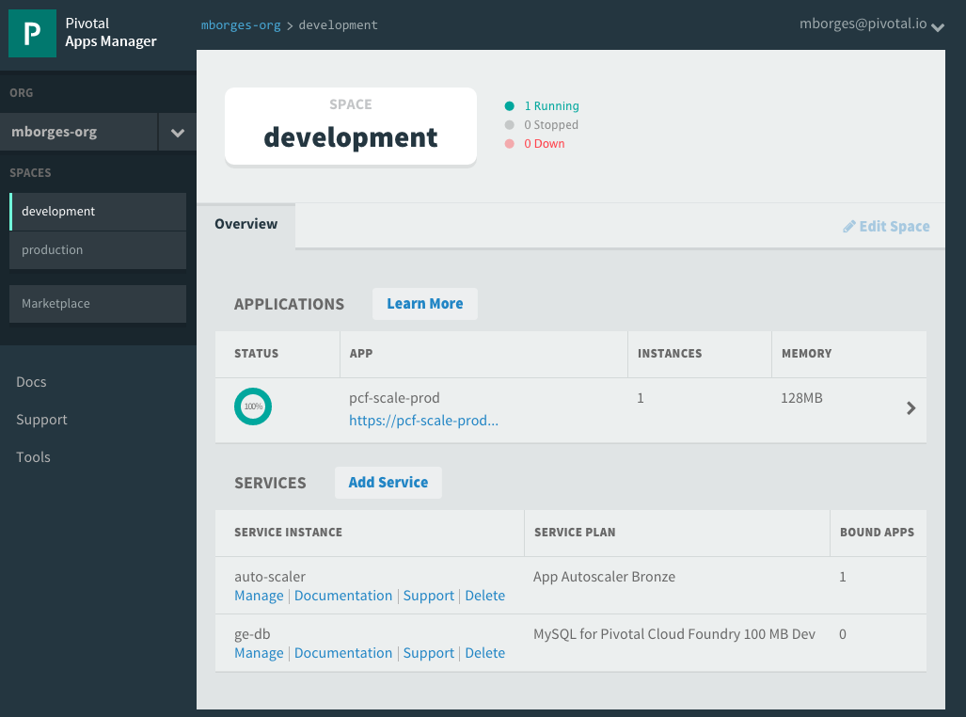
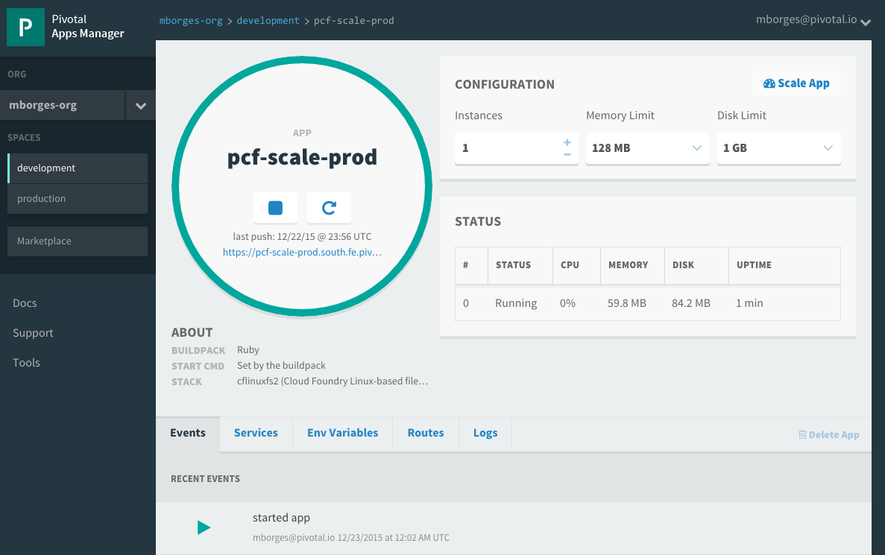
Pivotal Apps Mgr. – App View
Drill into a space to see all application and services instances
Then drill into an application to see configuration, status, event, logging, routes, environment variables and service instances bound to the application
Notes:
http://docs.pivotal.io/pivotalcf/console/index.html
This picture allows us to show the space view that provides quick overview of all applications and services target to it. Further application detail can be obtain by drilling into specific application. Notice that services can be managed via the quick manage link. The number of bounds apps is also showed.

Slide 28
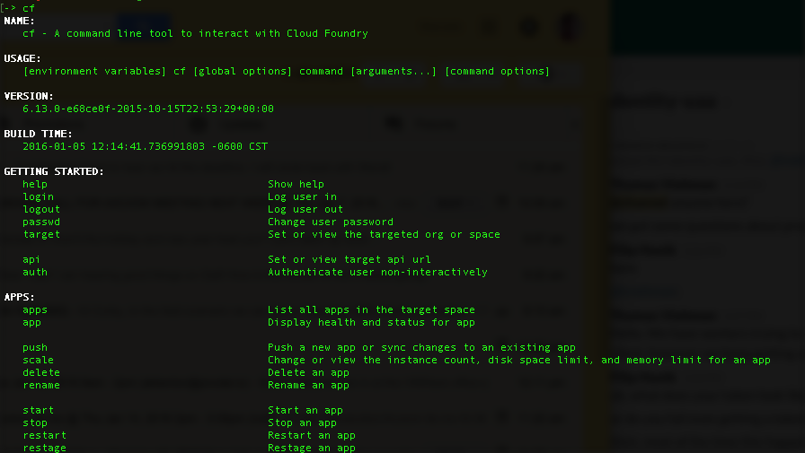
CLI – Command Line Interface
Command line utility providing easy access to the Pivotal CF commands.
Scriptable
Fully documented (cf –help)
Notes:
http://docs.pivotal.io/pivotalcf/console/index.html

Slide 29
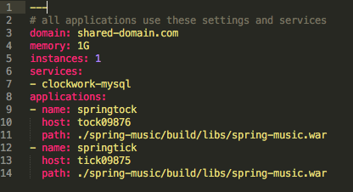
Manifest Files
Application manifests tells cf push what to do with applications
From how many instances to create and how much memory to use.
Help automate deployment, specially of multiple apps at once
Can list services to be bound to the application
YAML format – http://yaml.org
Notes:
https://docs.pivotal.io/pivotalcf/devguide/deploy-apps/manifest.html
YAML format - Default name is manifest.yml

Slide 30
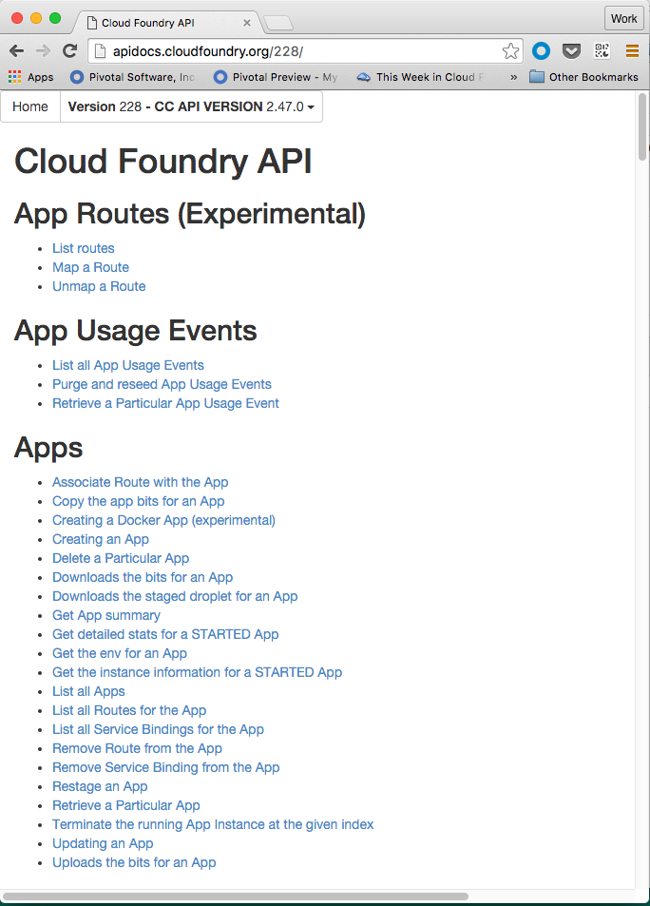
Cloud Controller API
Cloud Controller component of Elastic Runtime manages all Cloud Foundry APIs
CF CLI and other clients like Apps Manager directly call this API
Before accessing the CC API, you must get an access token from the ERS component called User Account and Authentication (UAA) server
http://apidocs.cloudfoundry.org
Notes:
http://docs.pivotal.io/pivotalcf/console/index.html

Slide 31
Orgs, Spaces, Users and Quota
Notes:
Multi-tenant platform

Slide 32
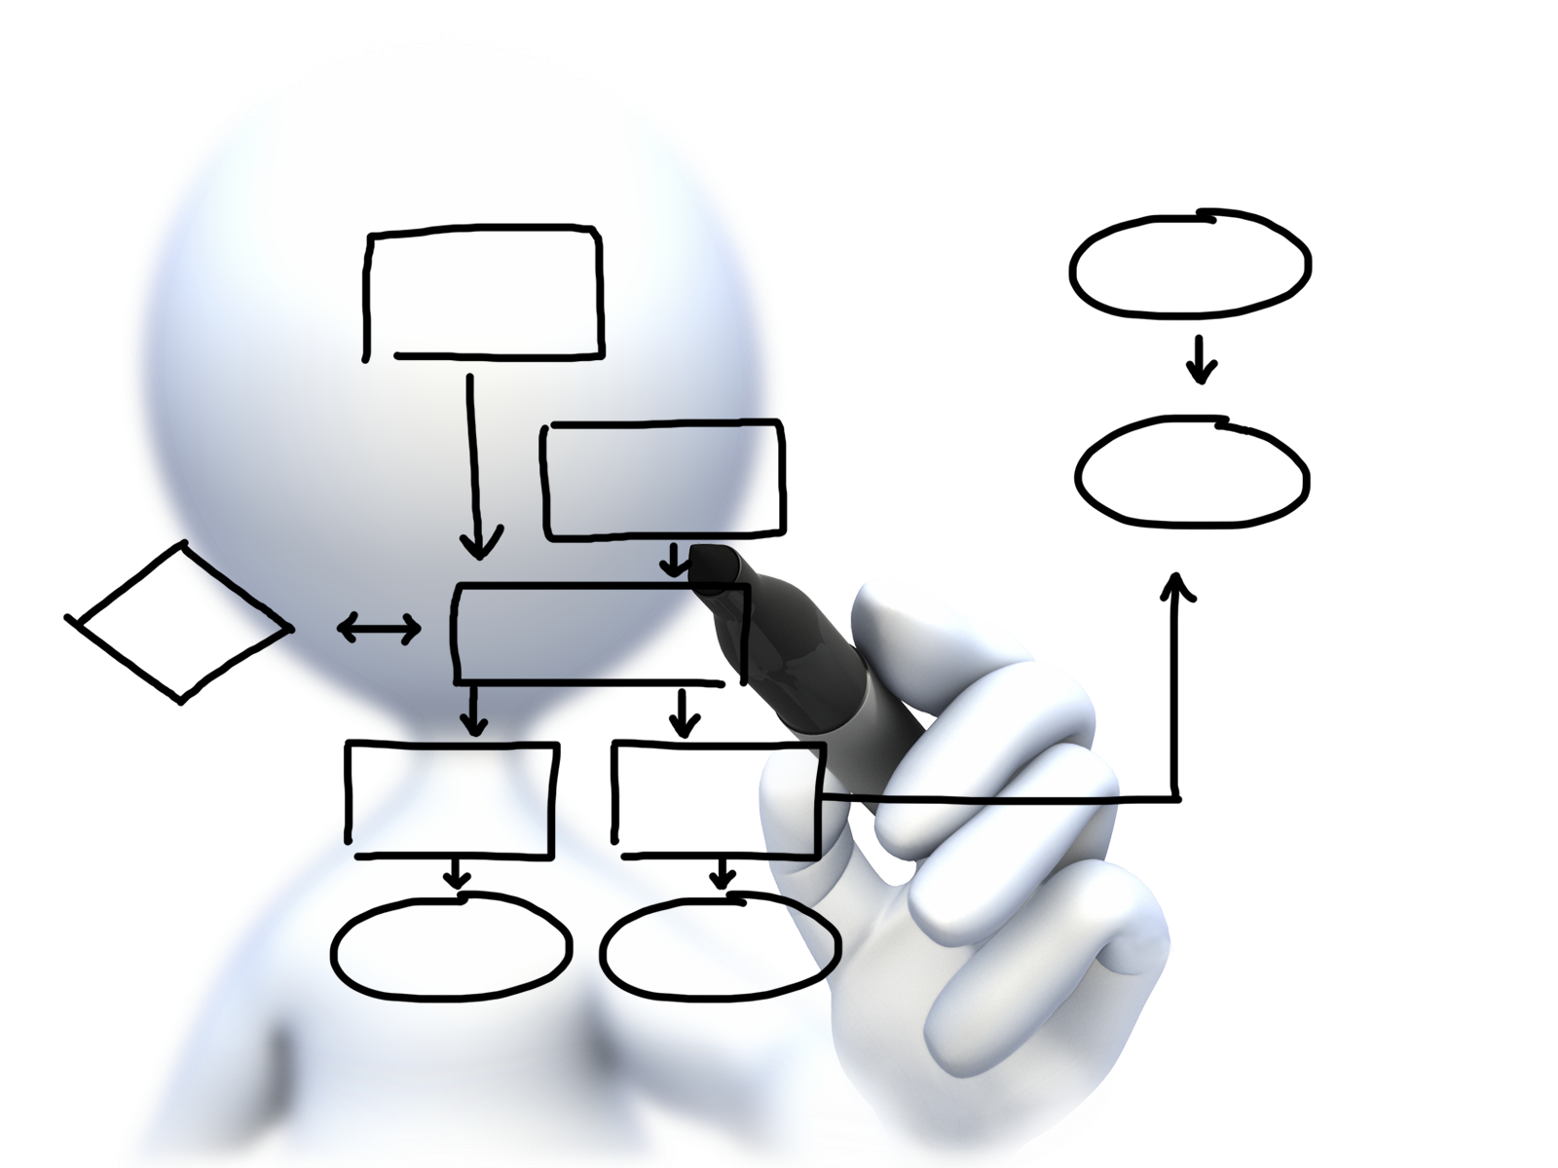
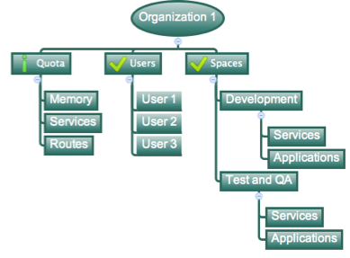
Orgs, Spaces, Users and Quotas
Cloud Foundry Installation
Notes:
https://docs.pivotal.io/pivotalcf/concepts/roles.html
Cloud Foundry uses role-based access control (RBAC), with each role graning permissions in either an org or a space.
Orgs: An org is a development account that an individual or multiple collaborators can own and use. All collaborators access an org with user accounts. Collaborators in a org share a resource quota plan, applications, services availability, and custom domains.
User Accounts: Represents an individual person within the context of a Cloud Foundry Installation. A user can have different roles in different spaces within an org, governing what level and type of access they have within the space.
Spaces: Every application and service is scoped to a space. Each org contains at least one space. A space provides users with access to a shared location for application development, deployment, and maintenance. Each space role applies only to a particular space.
Roles and Permissions (Maybe on its own slide): A user can have one or more roles. The combination of these roles defines the user’s overall permissions in the org and within specific spaces in that org.

Slide 33
Organizations
Top-most administrative unit
Logical division division within a Pivotal Cloud Foundry Install / Foundation
Typically a company, department, application suite or large project
Each organization has its own users and assigned quota
User permissions / Roles are specified per space within an organization
Sub-divided into spaces
Notes:
TDB: layout

Slide 34

Quotas and Plans
Different quota limits (e.g. small, enterprise, default, runaway) can be assigned per Organization
Quotas defines
Total Memory
Total # of services
Total # of Routes
Sub-divided into spaces
Notes:
TDB: layout
https://docs.pivotal.io/pivotalcf/opsguide/change-quota-plan.html
Note: Documentation seems very outdated and thin on this subject. Do some research
Quota plans are named sets of memory, service, and instance usage quotas. For example, one quota plan might allow up to 10 services, 10 routes, and 2 GB of RAM, while another might offer 100 services, 100 routes, and 10 GB of RAM. Quota plans have user-friendly names, but are identified by unique GUIDs.
Quota plans are not directly associated with user accounts. Instead, every organization has a list of available quota plans, and the account admin assigns a specific quota plan from the list to the organization. Everyone in the organization shares the quotas described by the plan.

Slide 35

Spaces
Logical sub-division within an organization
Users authorized at an organization level can have different roles per space
Services and Applications are created / target per Space
Same service name can have different meaning per space
Notes:
TDB: layout

Slide 36

Users and Roles
Users are members of an organization
Usually they are operators or developers (not application end users)
Users are sent an email invite and asked to create an account
Users have specific organization and space roles
Organization roles grant permissions in an organization
Space roles grant permissions in a particular space
A combination defines the user’s overall permissions
Notes:
TDB: layout

Slide 37
Buildpacks
Notes:
THIS SECTION INCORPORATES SLIDES FROM “PCF Basics and Arch 301” Deck

Slide 38
Platform Runtime – Application Frameworks
Container image
application layer
PCF buildpacks provide full support and maintenance for 3 of the 4 layers of the container stack
Devs can focus on just the app code
PCF creates the container image for you
runtime layer*
Dev Supported
PCF Supported
OS image
App container
Ops Supported
linux host & kernel
* Devs may bring a custom buildpack
Notes:
Introduction to buildpacks
Here we can compare and contrast with other container solutions like docker. We can bring up the advantages on the fact the container is built on the fly and that the buildpack provides consistency in building, updating and patching container images. Sometimes infrastructure people get’s concerned about the fact we bring our own OS images (stemcells) in regards to their “special” security and other needs. We need to find a subtle way to explain these “special” needs are often part of the problem. We should defer any detail security discussion as it can get hairy.

Slide 39
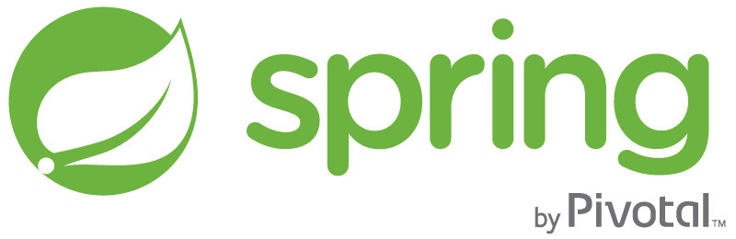
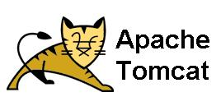
Runtime Benefits With PCF
runtime layer
6 Language Runtimes Maintained with Buildpacks
Java, Node, Python, PHP, Ruby, Go
Enterprise Support with Buildpacks
or Docker Images
Enterprise Middleware Support
Apache Tomcat Support from #1 Committer
Enterprise Framework Support
Spring is the #1 Enterprise Java Framework

Slide 40
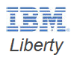
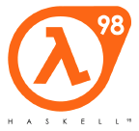

Custom Buildpacks
Cloud Foundry Community provides buildpacks for other languages
Or write your own
Usually by forking / adapting an existing buildpack
For list of CF Community Buildpacks
https://github.com/cloudfoundry-community/cf-docs-contrib/wiki/Buildpacks
Notes:
https://github.com/cloudfoundry-community/cf-docs-contrib/wiki/Buildpacks

Slide 41
LOgging
Notes:
THIS SECTION INCORPORATES SLIDES FROM “PCF Basics and Arch 301” Deck

Slide 42
Log Streaming and Aggregation
App Developers can tail their application logs or dump the recent logs from the CF CLI, or stream these to a third party log archive and analysis services
Operators and administrators can access the Loggregator firehose, the combined stream of logs from all apps, plus metrics data from CF components
Operators can deploy ‘nozzles’ to the firehose. A nozzle listens to the firehose for specified events and metrics. E.g syslog or datadog nozzle
Notes:
https://docs.pivotal.io/pivotalcf/loggregator/nozzle-tutorial.html
Avery Application instance starts streaming logs immediately
“Loggregator” component aggregates logs and streams back to different outputs
Streaming can be send directly to Splunk or other log aggregation and analytics tools

Slide 43
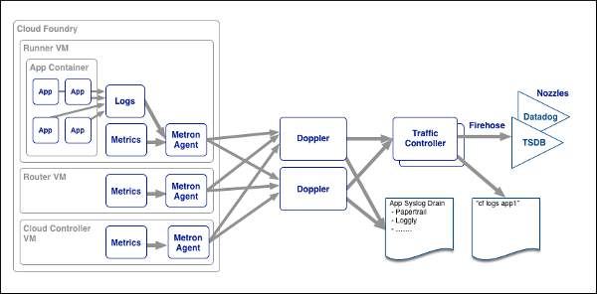
Loggregator Components
Notes:
https://docs.pivotal.io/pivotalcf/loggregator/architecture.html

Slide 44
Auto scaling
Notes:
THIS SECTION INCORPORATES SLIDES FROM “PCF Basics and Arch 301” Deck

Slide 45
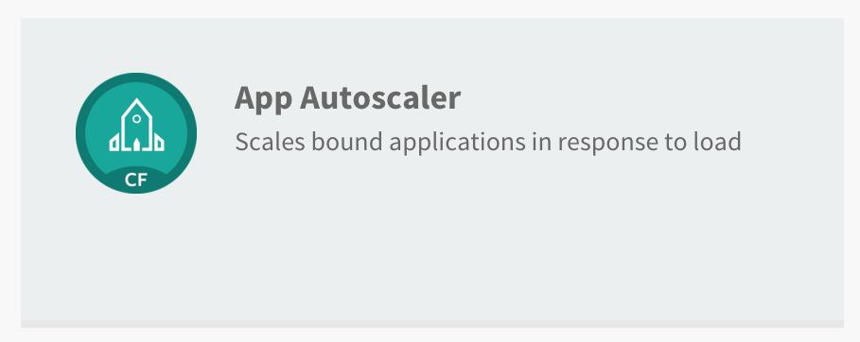
Available via the Marketplace

Slide 46
Service Plans
Bronze and Gold service plans
Major difference between plans is how often app is monitored
Bronze - every 5 minutes
Gold - every 30 seconds

Slide 47
Service Plans
Both plans provide:
Scaling app up and down according to user-provided load parameters
Scale based on one-time event or recurring schedules
Service management dashboard for configuration

Slide 48
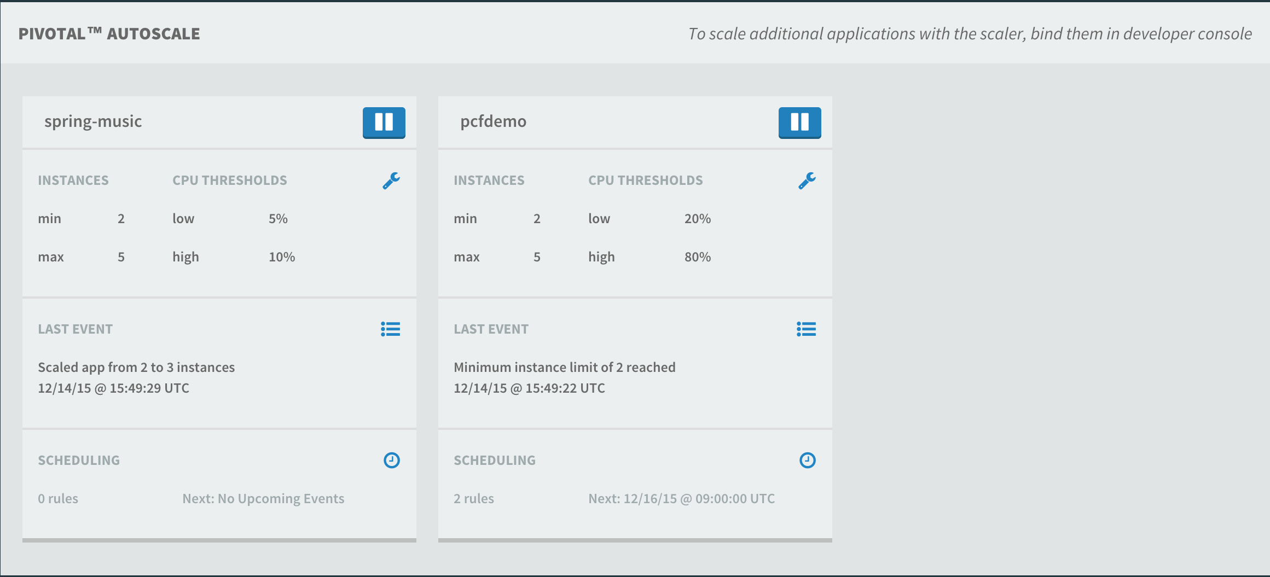
Service Management Dashboard

Slide 49
Demo Domains and routes
Notes:
THIS SECTION INCORPORATES SLIDES FROM “PCF Basics and Arch 301” Deck

Slide 50
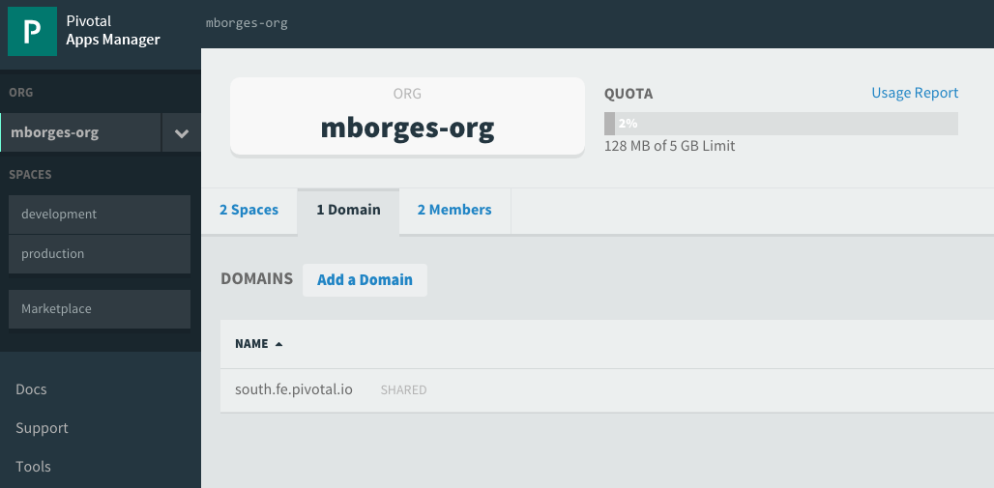
Domains
Each Cloud Foundry installation has a default app domain
Domains provide a namespace from which to create routes
Requests for any routes created from the domain will be routed to Elastic Runtime.
Domains can be shared or private in regards to PCF organizations
Notes:
https://docs.pivotal.io/pivotalcf/devguide/deploy-apps/routes-domains.html
Picture of PCF architecture HAProxy and Router using domain namesdns

Slide 51
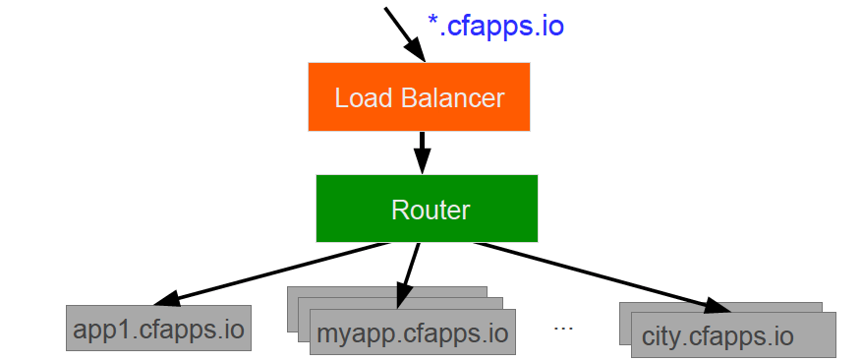
Domains – Behind the Scenes
A wildcard entry (*) is added to the DNS for the app domain
That DNS entry points to a load balancer (or Cloud Foundry’s HA Proxy), which points to the Cloud Foundry’s Router
The Router uses the subdomain to map to application instance(s)
Notes:
https://docs.pivotal.io/pivotalcf/devguide/deploy-apps/routes-domains.html
Picture of PCF architecture HAProxy and Router using domain namesdns

Slide 52
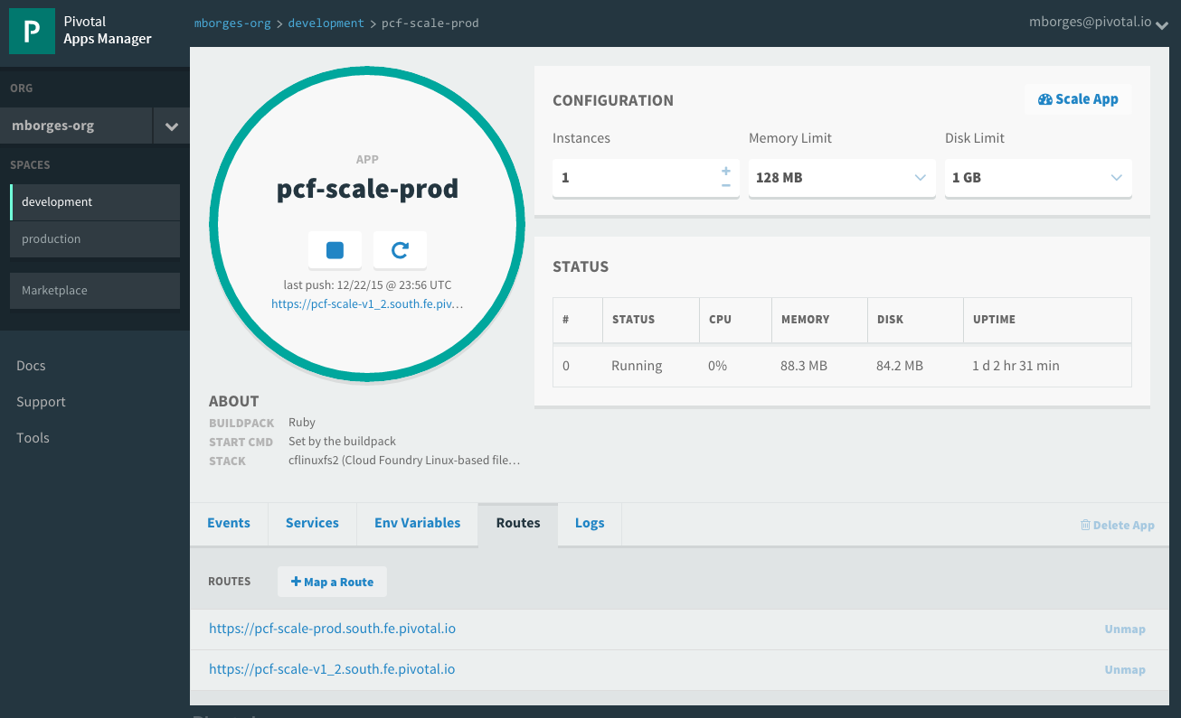
Routes
HTTP requests are routed to apps pushed by associating an application with a URL, know as route
Many apps can be mapped to a single route resulting in load balanced requests
Routes belong to a space
Application can have multiple routes
Notes:
https://docs.pivotal.io/pivotalcf/devguide/deploy-apps/routes-domains.html
TDB: Consider adding a picture instead of just showing Apps Manager

Slide 53
Basic troubleshooting
Notes:
THIS SECTION INCORPORATES SLIDES FROM “PCF Basics and Arch 301” Deck

Slide 54
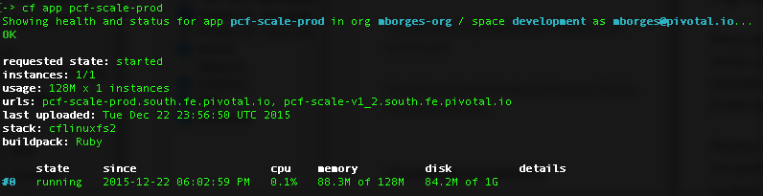
Health
Usage: cf app APP…
Show the running instances and health information for one or more applications
Example:

Slide 55

Events
Display application instance events (updates, crashes, …)
Usage: cf events [APP]
Example:

Slide 56

Logs
Print out an app's logs
Usage: cf logs [APP] Options: --recent Recent logs
Example:

Slide 57

Files
Print out a list of files in a directory or the contents of specific files
Usage: cf files APP_NAME [PATH] Options: -i Instance
Example:

Slide 58

Diego for PCF SSH access to containers
> cf ssh my-awesome-app
SSH Proxy Server
✓ Authenticate
✓ Locate target container
✓ Connect to the ssh daemon
✓ Manage communication
DEA /CELL
App
App
App
App
Notes:
*Note: Make sure to mention that this functionality should be used only in case deeper troubleshooting is required. The integrity of the platform has to be kept…we don't want to enable snowflakes. Operations can control ssh access…see more details below:
Diego SSH is composed by:
Implementation of an ssh proxy server
A SSH daemon
CF CLI plugin
The SSH proxy is the user accessible endpoint. It is responsible for: authentication, locating target container, establish the connection to the daemon running inside the container and after the connection is established, it manages the communication between user’s ssh client and container’s daemon.
SSH daemon supports:
Command executions
Interactive shells
Local port fowarding
SCP
It is made avalalble on a file server and can be donwloaded for Diego LRPs that want to use it. For CF apps the daemon will be downloaded as part of the lifecycle bundle.
Config tru CLI:
App: enable_ssh
CF space: allow_ssh
OPS Manager:
CC: allow_app_ssh_access

Slide 59
Basic services overview
Notes:
THIS SECTION INCORPORATES SLIDES FROM “PCF Basics and Arch 301” Deck

Slide 60


Productivity: Developer spend too much time waiting
0
2
4
6
8
10
12
14
Design and Coding
Brainstorming
Administrative Tasks
Managing Environments
Waiting for Test/Build
Task Breakdown
Average Hours / Week
Sources: “Electric Cloud LinkedIn Survey to software developers”
Notes:
Traditional CI/CD deployments setup with custom servers means that each app instance requires individual configuration and secured. This kicks off a whole set of checks and balances from your ops team. You have ticket-based manual provisioning. When you go to push an update, it’s too complex to automate and test automatically, so every update requires a sequence of manual steps and checks. You
As you can see in this survey of over a thousand developers, devs estimate that they spend a huge amount of time on administration and environment managing their environment, including 20% of their time waiting. So there are some obvious issues with
http://readwrite.com/2013/04/25/how-software-developers-really-spend-their-time

Slide 61

What is a Service?
Allows resources to be easily provisioned on-demand.
Typically middleware, frameworks, and other “components” necessary for applications.
Can be a persistent, stateful layer

Slide 62

2 types of Services
Managed – Fully integrated, with fully lifecycle management
User-Provided – Created and managed externally to the Platform.

Slide 63

Managed Services
Managed Services are integrated with PCF by implementing a documented API.
A self-service catalog of databases, analytics and middleware technologies:
Production ready
Integrated lifecycle management
Managed credentials
Role-based access
Service Broker is a component which implements the Service API. Service brokers advertise a catalog of service offerings and service plans to Cloud Foundry.

Slide 64



















Pivotal Cloud Foundry Service
Mobile
Datastore
Other
Cloud-native
API Gateway
Redis
DataStax Cassandra
RabbitMQ
Config Server
Push Notifications
MySQL
GemFire
Jenkins Enterprise by CloudBees
Service Directory
Data Sync
Session state caching
PivotalHD (BETA)
Spring XD (BETA)
Circuit Breaker
App Distribution
Neo4j (BETA)
MongoDB (BETA)
Single Sign-on

Slide 65

Service Creation & Binding
Service
credentials
DB
CLI
create service (HTTP)
Cloud Controller
create service (HTTP)
Service
Broker
reserve resources
Data
Service
Router
bind service (HTTP)
bind service (HTTP)
obtain connection data
Runtime
Notes:
An application runs in a DEA, which is a droplet execution agent. The Cloud Controller orchestrates the routing and lifecycle of all DEAs in the pool. Routers manage application traffic. Health Manager reports mismatched application states to the CC. A service gateway provides an interface for services (native or external). A messaging bus manages all system communication. Apps are accessed directly through the router while web and CLI clients (e.g., vmc, STS) access Cloud Controller via RESTful services.

Slide 66

Example: Service Creation & Binding
Click on "Marketplace"
Create Service
Bind service
Restart App
Verify

Slide 67

Example: Service Creation & Binding
Choose ”RabbitMQ for PCF"
Create Service
Bind service
Restart App
Verify

Slide 68

Example: Service Creation & Binding
Select the free plan
Create Service
Bind service
Restart App
Verify

Slide 69

Example: Service Creation & Binding
Give it a name and bind it to your application
Create Service
Bind service
Restart App
Verify

Slide 70

Example: Service Creation & Binding
Create Service
Bind service
Restart App
Verify

Slide 71


Slide 72

Example: Service Creation & Binding
$ cf env pcfdemo
Create Service
Bind service
Restart App
Verify

Slide 73

The magic is in Spring Cloud
Full details can be found here http://projects.spring.io/spring-cloud

Slide 74


Spring Cloud Connectors modules
Cloud Foundry Connector
Heroku Connector
Core
Spring Service Connector

Slide 75
User-Provided Service
User-provided - A user-provided service is simply a list of connection parameters that are stored in the platform and provided to an application when it binds to the service.
User-provided services are useful for quickly getting parameters to an application, without having to create a service broker and registering with it the platform. They are also helpful for services that will probably only be used once or twice.
Applications connect to the same instance.
User-provided services are created using the CF CLI’s create-user-provided-service command, which takes an arbitrary set of key/value pairs as an argument.
> cf create-user-provided-service my-old-db –p ‘{“user”:”admin”,”password”:”pwd”}’
Full instructions can be found here https://docs.pivotal.io/pivotalcf/devguide/services/user-provided.html

Slide 76
Blue/green deployment
Notes:
THIS SECTION INCORPORATES SLIDES FROM “PCF Basics and Arch 301” Deck

Slide 77
Blue-Green Deployments
Blue-Green deployment is an approach to upgrading application with minimal downtime.
It also enables easy rollback to the old version if the new version experiences problems
It works by keeping both versions online, and switching from the old version to the new version
live
traffic
app 1.0
app 1.0
live
traffic
app 1.1
app 1.1
Before
After
Notes:
https://docs.pivotal.io/pivotalcf/devguide/services/migrate-db.html
IMAGE FOUND ON GOOGLE – check

Slide 78
Blue-Green Deployments using Routes
Main idea: you always want myapp.cfapps.io to be good
Use routes to achieve this
Because you are in a single space, multiple application can use the same routes
myapp.cfapps.io
myapp.cfapps.io
app 1.0
app 1.0
app 1.0
myappdev.cfapps.io
app 1.1
myapp.cfapps.io
app 1.1
myapp.cfapps.io
app 1.1
Before
(working on version 1.1)
During
(version 1.1 is ready)
After
(done with version 1.0)
Notes:
https://docs.pivotal.io/pivotalcf/devguide/services/migrate-db.html
IMAGE FOUND ON GOOGLE – check

Slide 79
Slowly Turning on Traffic using Instances
Start with four instance of blue, one instance of green
80% of traffic will use version 1.0
Decrease blue instance, increase green instances as confidence builds
app 1.0
myapp.cfapps.io
app 1.0
app 1.0
app 1.0
app 1.1
app 1.1
myapp.cfapps.io
app 1.1
myapp.cfapps.io
app 1.1
app 1.1
Notes:
https://docs.pivotal.io/pivotalcf/devguide/services/migrate-db.html
IMAGE FOUND ON GOOGLE – check

Slide 80

DB Migrations for Cloud Foundry Services
Migrate Once
Service instance credentials can be obtained using cf env
Migrate Occasionally
Create a schema migration cmd or script
Run it when deploying a single instance of the app
Redeploy the app with the original cmd
Migrate Often
Uses idempotent script to partially automate migrations. The script runs on the first application instance only
Notes:
https://docs.pivotal.io/pivotalcf/devguide/services/migrate-db.html
IMAGE FOUND ON GOOGLE – check
DB migration tools – flyway
https://blog.pivotal.io/labs/labs/db-migrations-spring-project

Slide 81
Open.
Agile.
Cloud-Ready.

Slide 82
Platform Runtime – Buildpacks
Buildpacks are responsible for preparing the machine image for an application
}
Application
Buildpack
Container
Libraries
Droplet
DEA
Runtime
Operating System
Notes:
Application Framework -

Slide 83
Log Aggregation and CF Components
Health Monitor
Syslog
Syslog Aggregator
Cloud Controller
Syslog
Logstash
Messaging (NATS)
Splunk
Syslog
Cell
Pivotal CF Elastic Runtime
…
Syslog
Notes:
Libraries = runtime package managers like Ruby gems, Node modules, Python PIP packages
App bits are downloaded into image by DEA, buildpack may move them as necessary

Slide 84

Logs and Metrics Firehose
One stream for all app logs and metrics
Log lines
From applications and system components
HTTP Events
Raw http events to generate performance analysis
Counters
Track the number of increments in a time window
Gauges
Monitor a value that varies over time
Errors
Capture error source, code and message
Image credit: http://imgarcade.com/1/fire-hose-spraying-fire/
Notes:
Application performance monitoring is built into the platform. Pivotal aggregates and streams all system logs, including the load balancer, application, middleware, and operating system.
We also log and aggregate application deployment and scale events. You can combine Pivotal with Splunk or use a lower cost log event correlation system because we handle aggregation of multiple log sources. `When it comes to application metrics, we provide a multitude of IT operator data points, including routing counters and VM CPU/RAM health statistics. Each line of business can turn on auto-scaling that will increase/decrease the application instances when average CPU utilization goes up/down.
Lastly, Pivotal recognizes that some vendors can add monitor capabilities above/beyond what we provide. We strongly caution you against using “legacy” platforms like CA and HP, but App Dynamics and New Relic are PaaS aware and work out of the box with Pivotal CF.

Slide 85
MongoDB tile for PCF Dynamically provisioned MongoDB clusters
PCF Ops Manager Server
Mongo Ops Manager Server
✓ Authenticate
✓ Authenticate
✓ Locate MOM
✓ Locate MOM
✓ Connect to the API
✓ Connect to the API
✓ Deploy Broker
✓ Deploy Broker
MOM managed instances
Bosh Director
VM with MOM Agent
VM with MOM Agent
MongoDB OnDemand Broker
VM with MOM Agent
VM with MOM Agent
VM with MOM Agent
VM with MOM Agent
Notes:
*Note: Make sure to mention that this functionality should be used only in case deeper troubleshooting is required. The integrity of the platform has to be kept…we don't want to enable snowflakes. Operations can control ssh access…see more details below:
Diego SSH is composed by:
Implementation of an ssh proxy server
A SSH daemon
CF CLI plugin
The SSH proxy is the user accessible endpoint. It is responsible for: authentication, locating target container, establish the connection to the daemon running inside the container and after the connection is established, it manages the communication between user’s ssh client and container’s daemon.
SSH daemon supports:
Command executions
Interactive shells
Local port fowarding
SCP
It is made avalalble on a file server and can be donwloaded for Diego LRPs that want to use it. For CF apps the daemon will be downloaded as part of the lifecycle bundle.
Config tru CLI:
App: enable_ssh
CF space: allow_ssh
OPS Manager:
CC: allow_app_ssh_access

Slide 86
Mongo Instance
PCF Ops mgr provisions VM
Mongo Ops Mgr provisions Instance
Mongo Ops mgr manages Instances
Apps Manager

Slide 87
CF CLI
PCF Ops Mgr
B o s h
PCF Apps Mgr
Elastic Runtime (Marketplace, etc.)
Mongo On Demand Broker
Bosh 2.0 svcs
1.
Mongo Ops Manager
MOM managed
Instances:
Single Instance
3-Node Cluster
9-Node Sharded Cluster
VM with MOM Agent
VM with MOM Agent
VM with MOM Agent
VM with MOM Agent
VM with MOM Agent
VM with MOM Agent
VM with MOM Agent
VM with MOM Agent

Slide 88

Speed and safety are both required
Addressing customer needs faster, with less downtime retains your customers
Protecting market share from disruptors or something unforeseen
The first to successfully rollout the innovation tends to win, defines the category
Being able to make quick experiments (that aren’t destabilizing) gives you
more chances at success
Notes:
People always say faster is better. Pivotal is business because we think speed and safety is better together.
Netflix started with Amazon’s EC2 service only -- that was all that was available back then. The microservice approach gave them speed, but safety required expensive R&D and hard to acquire talent as they to invent all the safety controls from scratch – the app framework, the runtime platform, and the infrastructure automation. This was all before writing one single line of code that relates to the application you and I know as Netflix.
Cloud adds complexity, so safety is just as important as the speed derived:
-Less downtime might be the difference between a customer lost or retained. Similarly, experiments aimed at customer satisfaction are the same way – rolling out a new but slow mobile app doesn’t help you that much.
-Perhaps you’re the incumbent. When you debut your response to competitor’s disruptions, there is no room for outages or slow performance or the impact / impression you make is “me too” and not “this is the idea done right!” regardless of how cool the app is.
-If you’re the disruptor, your product better work – it might be all you have!
Notes:
OODA loop – observe oriented, decide act – john boyd
http://www.hdwallpapers.in/walls/airplane_wing-wide.jpg

Slide 89
Introducing BOSH concepts

Slide 90

Perspective on BOSH

Slide 91
BOSH & Cloud Foundry
apps
Cloud
Foundry
services
containers
BOSH
VMs
IaaS
Hardware

Slide 92

The BOSH Architecture
Director
DB
Blobstore
CLI
Workers
NATS
Health Monitor
CPI
Agents
DB
Blob Store
CLI
Director
Worker
NATS
Health Monitor
CPI
Inner shell
Agents
Outer shell

Slide 93
What is BOSH?
BOSH is an OSS project that unifies release engineering, deployment, and lifecycle management of small and large-scale cloud software.
BOSH allows individual developers and teams to easily version, package and deploy software in a reproducible manner.
Notes:
BOSH allows individual developers and teams to easily version, package and deploy software in a reproducible manner.
Any software, whether it is a simple static site or a complex multi-component service, will need to be updated and repackaged at some point. This updated software might need to be deployed to a cluster, or it might need to be packaged for end-users to deploy to their own servers. In a lot of cases, the developers who produced the software will be deploying it to their own production environment. Usually, a team will use a staging, development, or demo environment that is similarly configured to their production environment to verify that updates run as expected. These staging environments are often taxing to build and administer. Maintaining consistency between multiple environments is often painful to manage.

Slide 94
4 principles of modern Release Engineering
Identifiability: Being able to identify all of the source, tools, environment, and other components that make up a particular release.
Reproducibility: The ability to integrate source, third party components, data, and deployment externals of a software system in order to guarantee operational stability
Notes:
BOSH was purposefully constructed to address the four principles of modern Release Engineering:
Identifiability: BOSH has a concept of a software release which packages up all related source code, binary assets, configuration etc. This allows users to easily track contents of a particular release. In addition to releases BOSH provides a way to capture all Operating System dependencies as one image
Reproducibility: BOSH tool chain provides a centralized server that manages software releases, Operating System images, persistent data, and system configuration. It provides a clear and simple way of operating a deployed system.

Slide 95
4 principles of modern Release Engineering
Consistency: the mission to provide a stable framework for development, deployment, audit, and accountability for software components.
Agility: the ongoing research into what are the repercussions of modern software engineering practices on the productivity in the software cycle, i.e. continuous integration.
Notes:
Consistency: BOSH software releases workflows are used throughout the development of the software and when the system needs to be deployed. BOSH centralized server allows users to see and track changes made to the deployed system
Agility: BOSH tool chain integrates well with current best practices of software engineering (including Continuous Delivery) by providing ways to easily create software releases in an automated way and to update complex deployed systems with simple commands.

Slide 96
Purpose-built for “Day 2 Operations”
Consistent, Reliable, Scalable, Secure
Provision
Deploy and Configure
Checks against “desired state” to return consistency
No ad hoc automation burden
Manage services, not servers
Self Healing
Current
State
Desired
State
Re-mediate
Monitor and Detect

Slide 97

Designed to be “Manageable & Productive”
Provision services, not machines
Enables continuous delivery
Cloud-agnostic view of Platform Ops
Holistic Toolchain for “rule them all"
Eliminate bespoke automation on top of config management
Notes:
Developer/operator communities have come far in solving similar situations with tools like Chef, Puppet, and Docker. However, each organization solves these problems in a different way, which usually involves a variety of different, and not necessarily well-integrated, tools. While these tools exist to solve the individual parts of versioning, packaging, and deploying software reproducibly, BOSH was designed to do each of these as a whole.

Slide 98






BOSH: Cloud Provider Interface
Stemcell
create_stemcell(image, cloud_properties)
delete_stemcell(stemcell_id)
VM
create_vm(agent_id, stemcell_id, resource_pool,
networks, disk_locality, env)
delete_vm(vm_id)
reboot_vm(vm_id)
configure_networks(vm_id, networks)
Disk
create_disk(size, vm_locality)
delete_disk(disk_id)
attach_disk(vm_id, disk_id)
detach_disk(vm_id, disk_id)
IaaS Neutral
...ETC

Slide 99

















































Cloud Foundry Foundation
An Open Industry Standard
PLATINUM
GOLD
SILVER
Notes:
Open source software offers true community-driven outcomes. Cloud Foundry Foundation has 40+ companies that participate in the community with a vested interest in a platform that continues to grow and meet customer needs, now and in the future.

Slide 100


